Slide 1
Sequential model

Slide 2
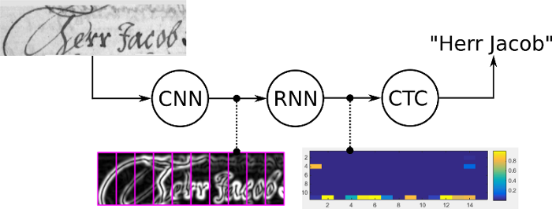
OCR

Slide 3
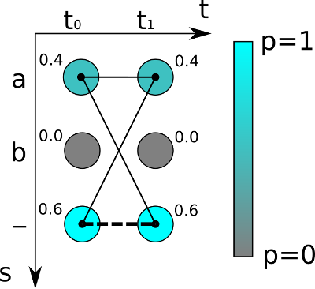
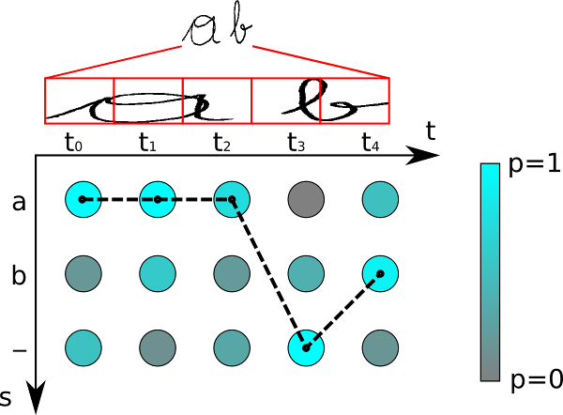
CTC loss
Notes:
https://towardsdatascience.com/intuitively-understanding-connectionist-temporal-classification-3797e43a86c
https://towardsdatascience.com/beam-search-decoding-in-ctc-trained-neural-networks-5a889a3d85a7

Slide 4
Practice
Seq2seq with attention
Bai tap giua ki

